Slide 1
19CSE435: Computer Vision
Image alignment

Slide 2
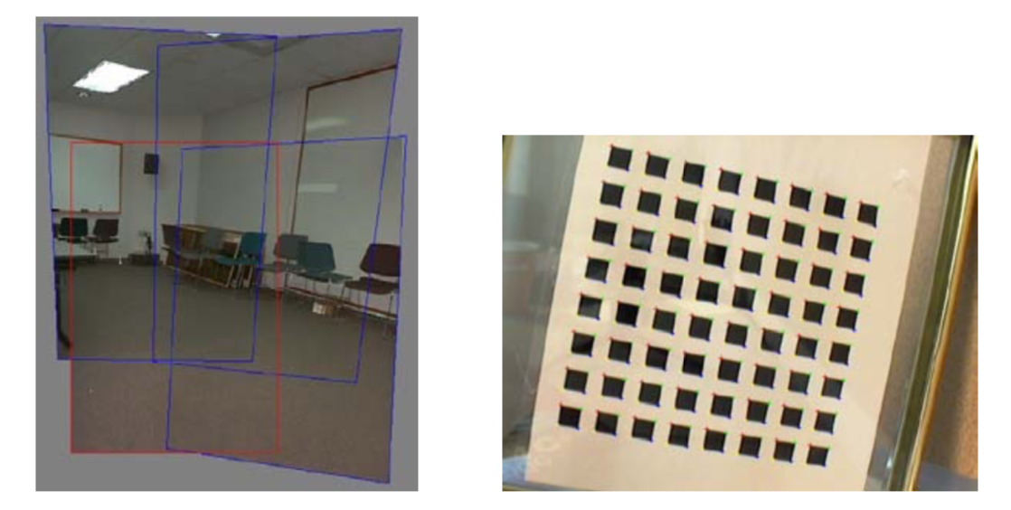
Feature-based Image Alignment
Geometric image registration
2D or 3D transforms between them
Special cases: pose estimation, calibration
Image credit Szeliski book

Slide 3
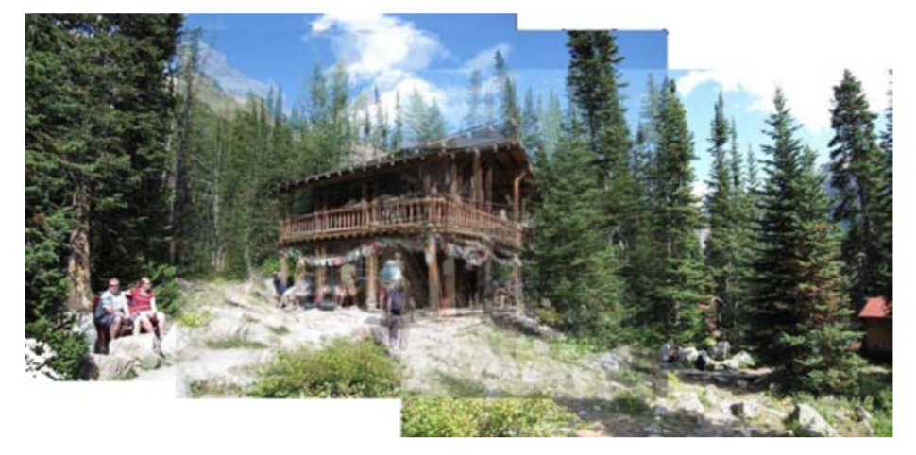
2D Alignment
3 photos
Translational model
Image credit Szeliski book

Slide 4
2D Alignment
Input:
A set of matches {(x_{i}, x_{i}’)}
A parametric model f(x; p)
Output:
Best model p*
How?
Image credit Szeliski book

Slide 5
2D translation estimation
Input:
Set of matches {(x₁, x₁’), (x₂, x₂’), (x₃, x₃’), (x₄, x₄’)}
Parametric model: f(x; t) = x + t
Parameters p == t, location of origin of A in B
Output:
Best model p*
Image credit Szeliski book

Slide 6
2D translation estimation
Input:
Set of matches {(x₁, x₁’), (x₂, x₂’), (x₃, x₃’), (x₄, x₄’)}
Parametric model: f(x; t) = x + t
Parameters p == t, location of origin of A in B
Question for class:
What is your best guess for model p* ??
Image credit Szeliski book
Notes:
What is your best guess? With one correspondence?
x1 = [600, 150], x1’ = [50, 50] -> x’ = x - t => t = x-x’ = [600-50, 150-50] = [550, 100]

Slide 7
2D translation estimation
[-550, -100]
How?
One correspondence x1 = [600, 150], x1’ = [50, 50]
Parametric model: x’ = f(x; t) = x + t => t = x’- x
=> t = [50-600, 40-150] = [-550, -100]
Image credit Szeliski book

Slide 8
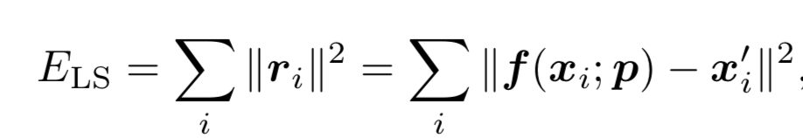
2D translation via least-squares
How?
A set of matches {(x_{i}, x_{i}’)}
Parametric model: f(x; t) = x + t
Minimize sum of squared residuals:
Image credit Szeliski book

Slide 9
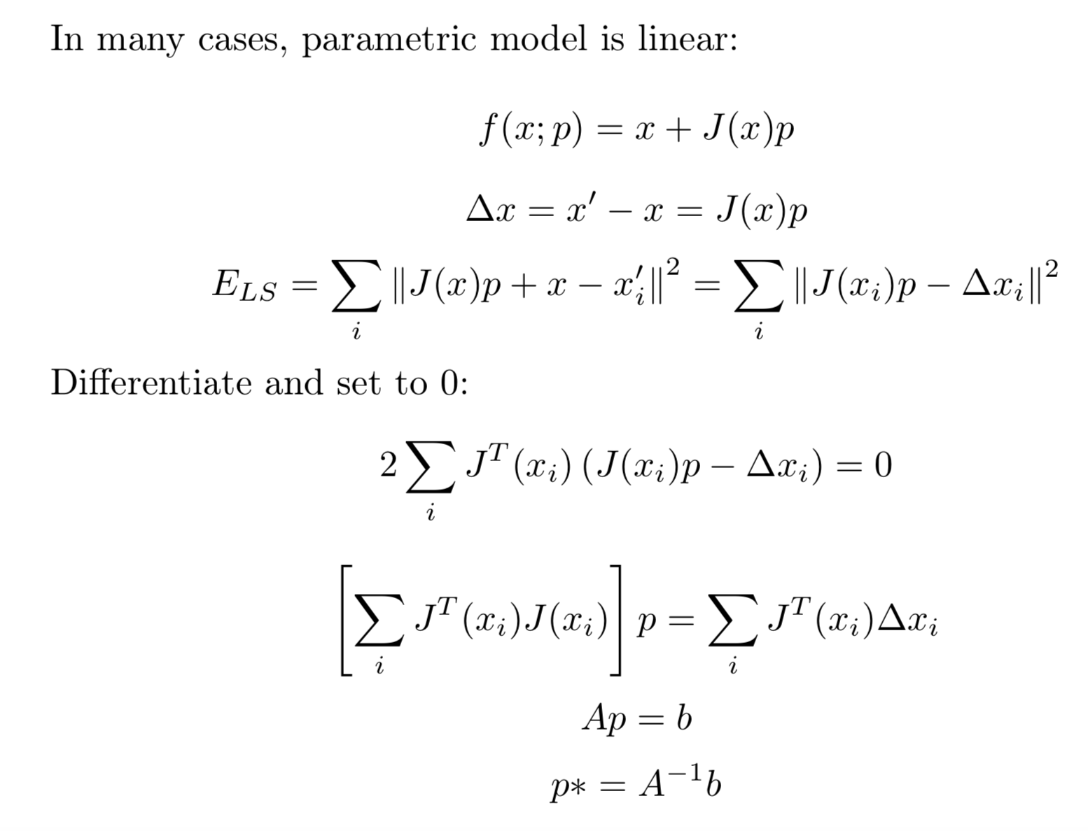



How to solve?
Jacobian
Normal equations
Hessian

Slide 10
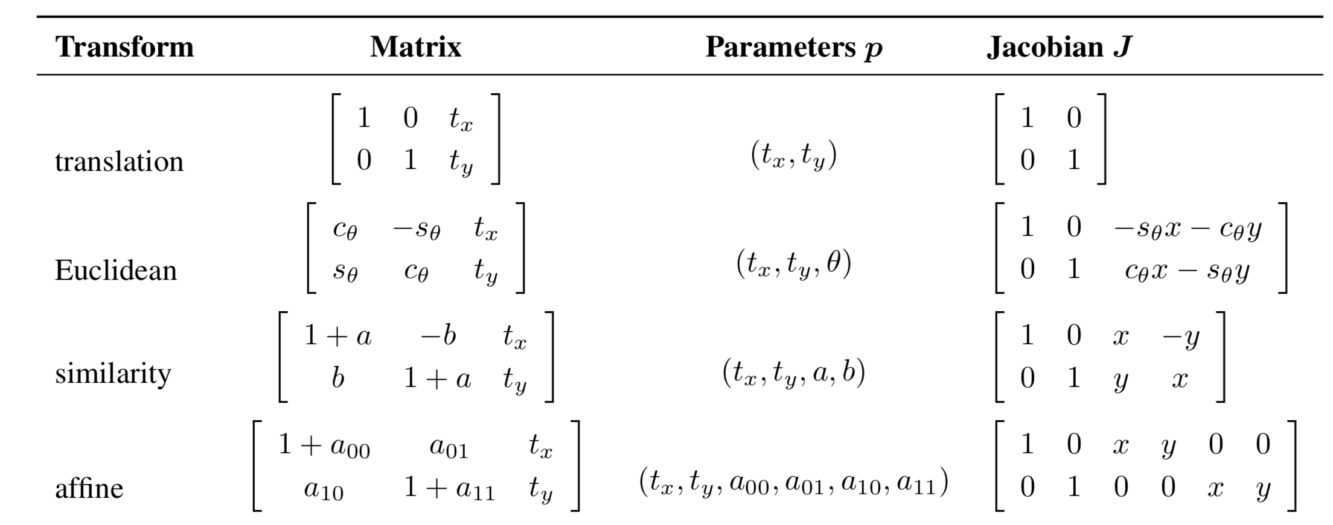
Linear models menagerie
All the simple 2D models are linear!
Exception: perspective transform
Figure credit Szeliski book

Slide 11
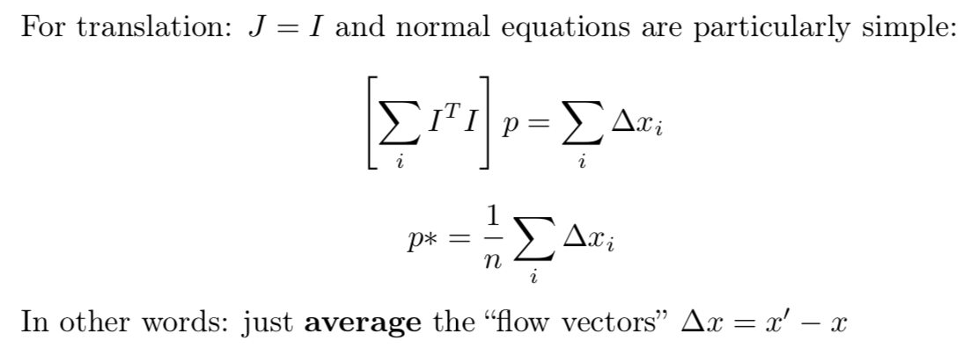
2D translation via least-squares
Image credit Szeliski book

Slide 12
Oops I lied !!! Euclidean is not linear!
All the simple 2D models are linear!
Euclidean Jacobians are a function of θ!
Figure credit Szeliski book

Slide 13
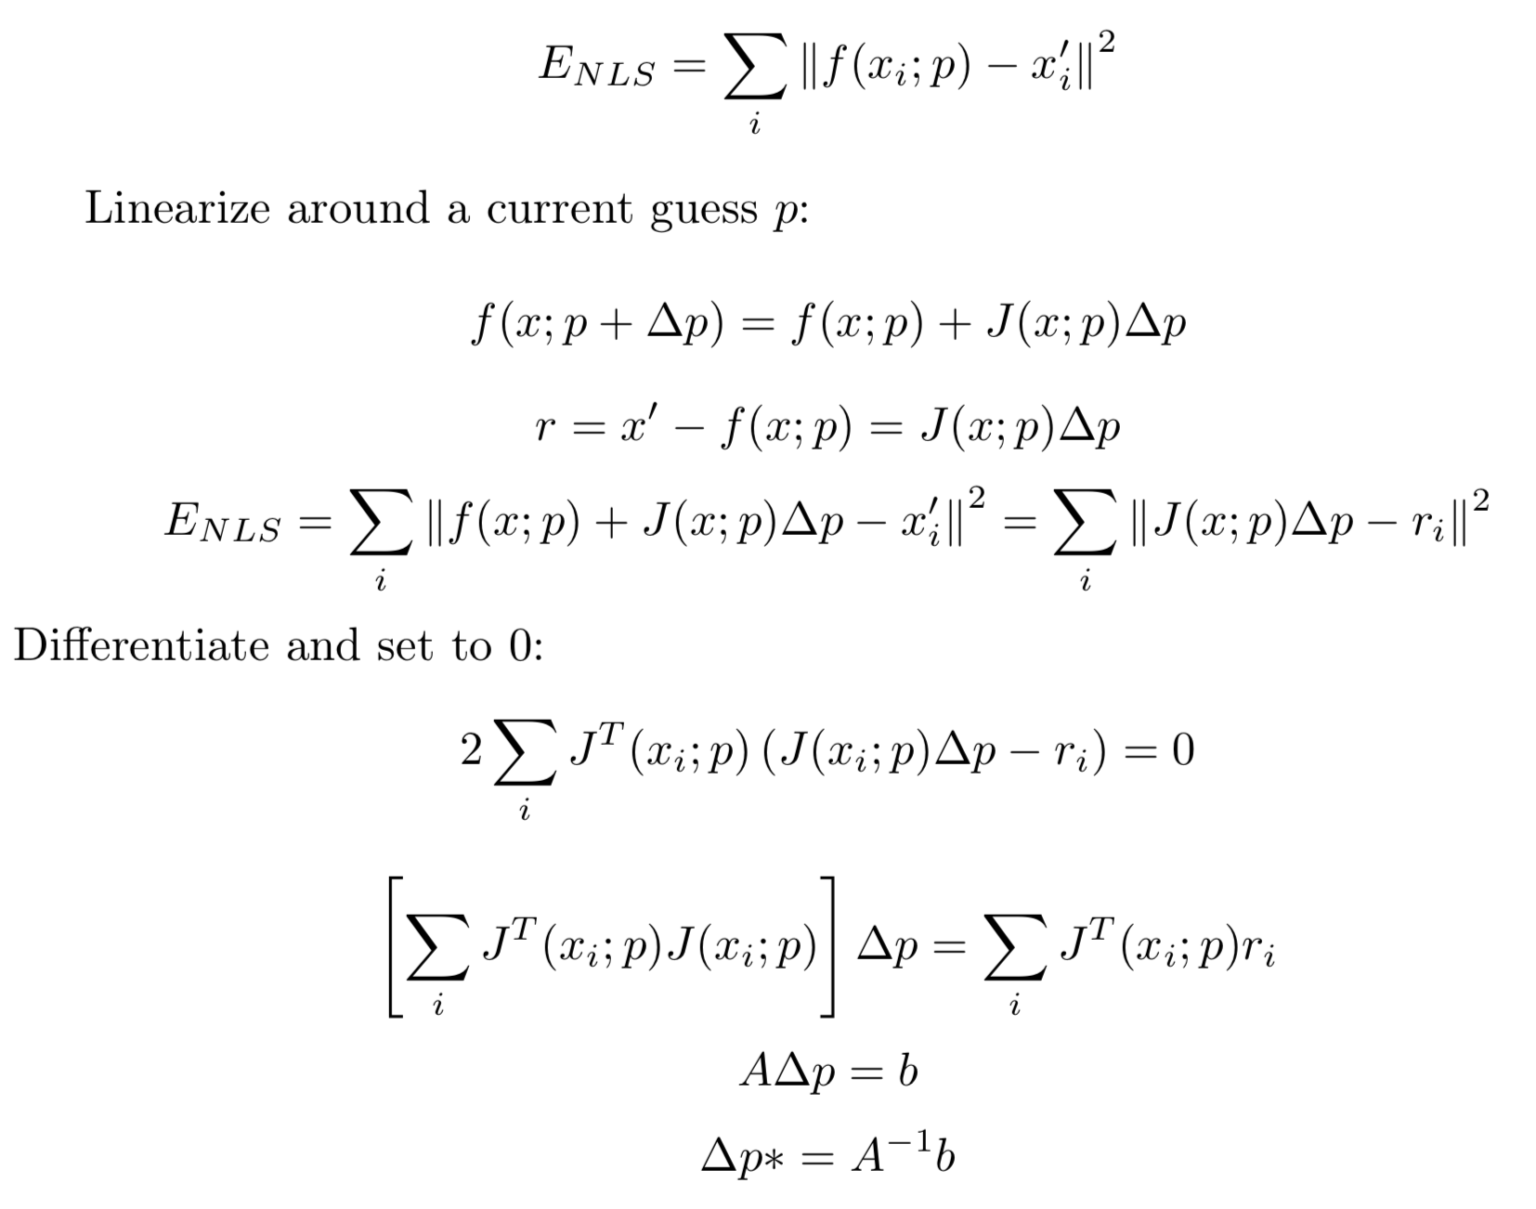
Nonlinear Least Squares

Slide 14
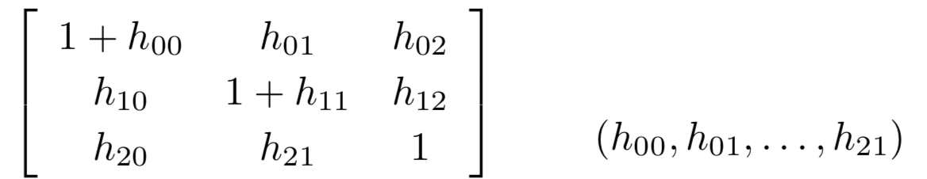
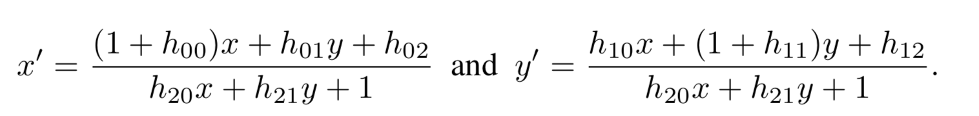
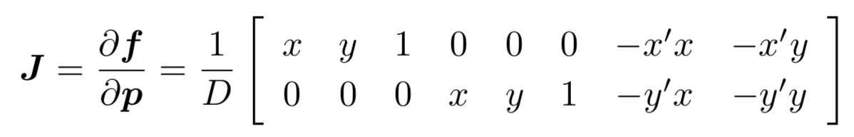
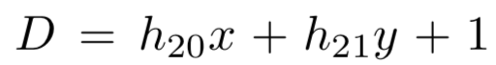
Projective/H
Jacobians a bit harder
Parameterization:
x’= f(x,p):
And Jacobian:
Image credit Graphics Mill
(educational Use)

Slide 15
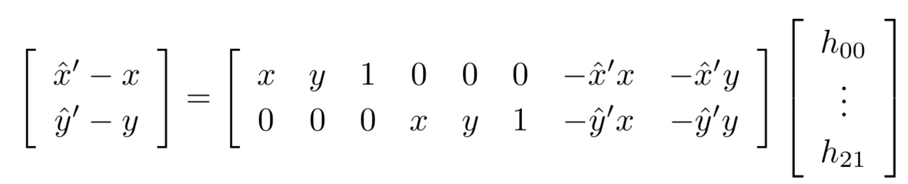
Closed Form H
Taking x’=f(x,p):
Divide both sides by :
4 matches => system of 8 linear equations
Image credit Graphics Mill
(educational Use)

Slide 16
RANSAC

Slide 17
Motivation
Estimating motion models
Typically: points in two images
Candidates:
Translation
Homography
Fundamental matrix

Slide 18




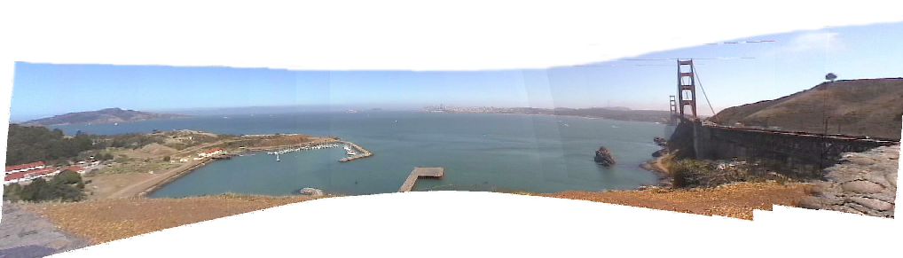
Mosaicking: Homography
www.cs.cmu.edu/~dellaert/mosaicking

Slide 19
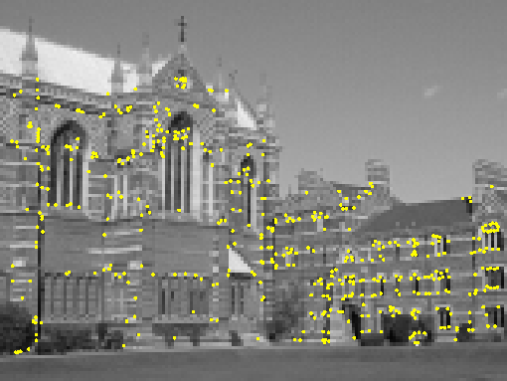
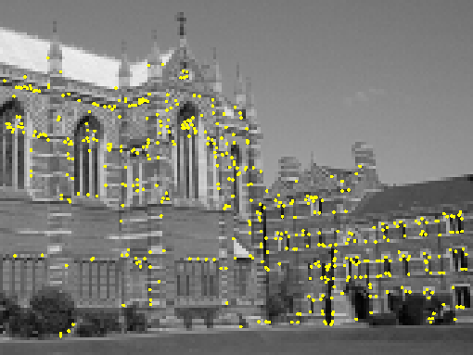
Two-view geometry (next lecture)
Notes:
Show two images
How can we match them up ?

Slide 20
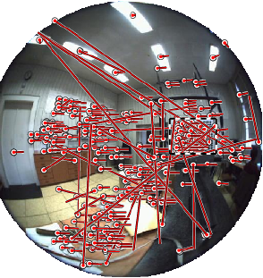
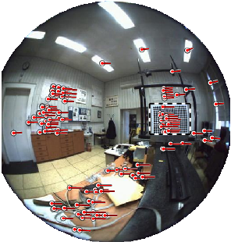
Omnidirectional example
Images by Branislav Micusik, Tomas Pajdla,
cmp.felk.cvut.cz/ demos/Fishepip/

Slide 21
Simpler Example
Fitting a straight line

Slide 22
Discard Outliers
No point with d>t
RANSAC:
RANdom SAmple Consensus
Fischler & Bolles 1981
Copes with a large proportion of outliers
Image credit Choi et al BMVC 2009

Slide 23
Main Idea
Select 2 points at random
Fit a line
“Support” = number of inliers
Line with most inliers wins
Image credit shutterstock, academic use

Slide 24
Why will this work ?

Slide 25
Best Line has most support
More support -> better fit
Image credit Wikipedia

Slide 26
In General
Fit a more general model
Sample = minimal subset
Translation ?
Homography ?
Euclidean transorm ?

Slide 27
RANSAC
Objective:
Robust fit of a model to data D
Algorithm
Randomly select s points
Instantiate a model
Get consensus set D_{i}
If |D_{i}|>T, terminate and return model
Repeat for N trials, return model with max |D_{i}|
Image credit Wikipedia

Slide 28
Distance Threshold
Requires noise distribution
Gaussian noise with σ
Chi-squared distribution with DOF m
95% cumulative:
Line, F: m=1, t=3.84 σ²
Translation, homography: m=2, t=5.99\ σ²
I.e. -> 95% prob that d<t is inlier
Image credit Wikipedia

Slide 29
How many samples ?
We want: at least one sample with all inliers
Can’t guarantee: probability P
E.g. P = 0.99
Image credit Wikipedia

Slide 30
Calculate N
If etha = outlier probability
proportion of inliers p = 1-etha
P(sample with all inliers) = p^{s}
P(sample with an outlier) = 1-p^{s}
P(N samples an outlier) = (1-p^{s})^N
We want P(N samples an outlier) < 1-P e.g. 0.01
(1-p^{s})^N < 1-P
N > log(1-P)/log(1-p^{s})
Image credit Wikipedia

Slide 31
Example
P=0.99
s=2, etha=5% => N=2
s=2, etha=50% => N=17
s=4, etha=5% => N=3
s=4, etha=50% => N=72
s=8, etha=5% => N=5
s=8, etha=50% => N=1177
Image credit Wikipedia

Slide 32
Remarks
N = f(etha), not the number of points
N increases steeply with s
Image credit Wikipedia

Slide 33
Threshold T
Terminate if |D_{i}|>T
Rule of thumb: T ≈ #inliers
So, T = (1-etha)n = pn
Image credit Wikipedia

Slide 34
Adaptive N
When etha is unknown ?
Start with etha = 50%, N=inf
Repeat:
Sample s, fit model
-> update etha as |outliers|/n
-> set N=f(etha, s, p)
Terminate when N samples seen
Image credit Wikipedia

